Slide 1
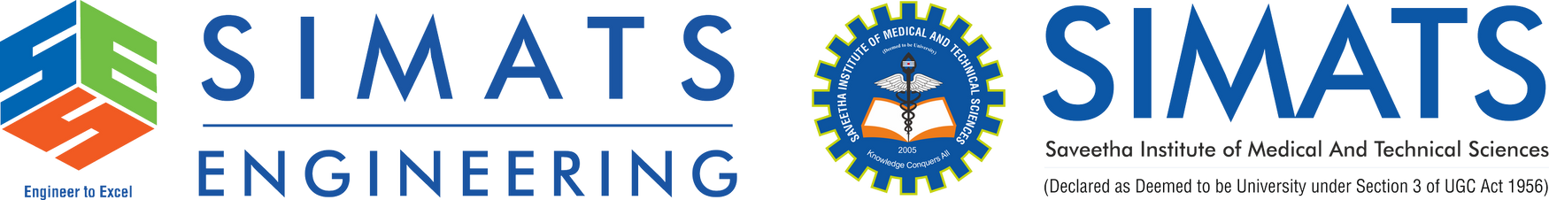
The Role of Artificial Intelligence and Machine Learning in Cloud Platforms
CSA1511 - CLOUD COMPUTING AND BIG DATA ANALYTICS
PRESENTED BY
GUIDED BY
TALARI VISHNUVARDHAN (192572091)
Dr.R.Hemavathi

Slide 2


AGENDA
S.NO | TOPIC | SLIDE NO
1 | Introduction | 3
2 | Problem Statement | 4
3 | Objective | 5
4 | Conclusion | 12
5 | Future Scope | 13

Slide 3
INTRODUCTION
AI and ML enable computers to learn from data and make intelligent decisions.
Cloud platforms provide computing power, storage, and AI services over the internet.
The combination of AI, ML, and cloud computing helps build smart and scalable applications.
Cloud providers like AWS, Microsoft Azure, and Google Cloud offer ready-to-use AI and ML tools.
AI-powered cloud platforms are widely used in healthcare, finance, retail, and education to improve efficiency and innovation.

Slide 4
PROBLEM STATEMENT
4
High infrastructure cost makes it difficult for organizations to develop and deploy AI/ML applications on local systems.
Processing large volumes of data requires scalable computing resources that traditional systems cannot efficiently provide.
Deploying and managing AI models is complex without cloud-based automation and monitoring services.
Real-time data analysis is challenging due to limited computing power and storage in on-premises environments.
Organizations need secure, scalable, and cost-effective AI solutions to improve decision-making and business performance.

Slide 5
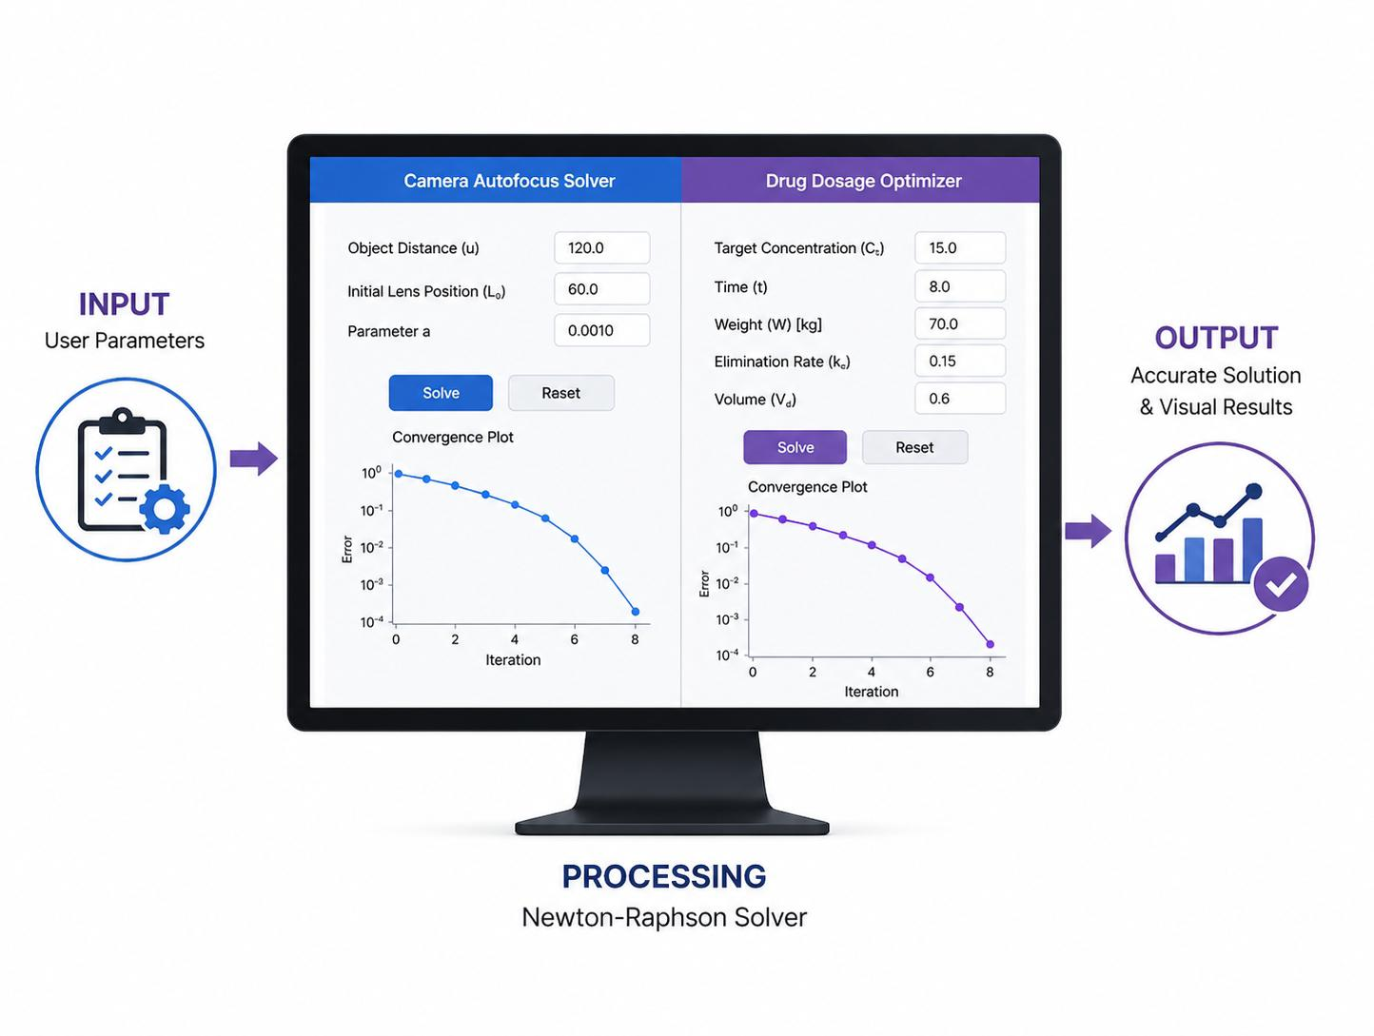
OBJECTIVE
5
To understand the role of Artificial Intelligence (AI) and Machine Learning (ML) in cloud computing.
To explain the architecture and working of AI/ML services on cloud platforms.
To explore the real-world applications and industry benefits of AI and ML in cloud environments.

Slide 6
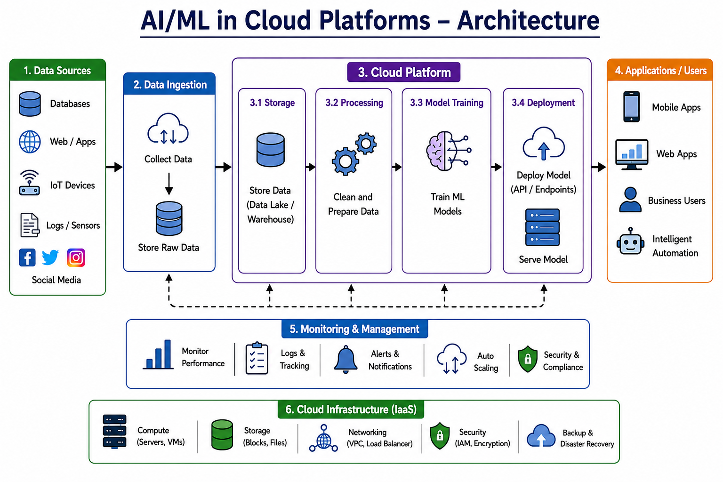
6

Slide 7
Cloud Computing Services Used
SaaS: Google Maps application used by the customer.
PaaS: Platform to develop and deploy AI features.
IaaS: Cloud servers that process maps and route requests.
DBaaS: Stores user profiles, saved places, and travel history
Faster and smarter navigation .Real-time traffic and weather updates
Multi-device synchronization AI-based route recommendations
Reduced travel time and cost Personalized travel planning
Automatic data backup and recovery Improved user safety
High scalability and reliability

Slide 8
FUTURE SCOPE
Smarter AI Services Future cloud platforms will provide more advanced AI and ML services with higher accuracy and faster decision-making.
Edge AI and IoT Integration AI will work together with Edge Computing and IoT devices to enable real-time data processing and intelligent automation.
Improved Security and Privacy Future cloud platforms will use AI-based cybersecurity, encryption, and privacy techniques to protect sensitive data.
Wider Industry Adoption AI-powered cloud platforms will be widely adopted in healthcare, finance, education, agriculture, manufacturing, and smart cities to improve efficiency and innovation

Slide 9
CONCLUSION
AI and Machine Learning, combined with cloud computing, enable intelligent, scalable, and cost-effective solutions.
Cloud platforms simplify the development, deployment, and management of AI applications by providing powerful computing resources.
AI-powered cloud services are transforming industries such as healthcare, finance, education, retail, and manufacturing through automation and data-driven decision-making.
As AI and cloud technologies continue to evolve, they will play a key role in driving innovation, digital transformation, and the future of smart computing.

Slide 10


